Slide 1
Implementation of WGM AOP1 for 2010 and planning for 2011,2012
Dr. Lei Xiaotu (China), Chair of WGM
Ivan LEONG (Macao, China), Expert team coordinator

Slide 2
WGM AOP1 for 2010
Assessment of climate change on tropical cyclone in TC region (II) track and impact area
To publish the 1st report “Assessment report of the impacts of climate change on tropical cyclone region (I) frequency and intensity”
To set up or extend the expert team
To make a draft of the 2nd report

Slide 3
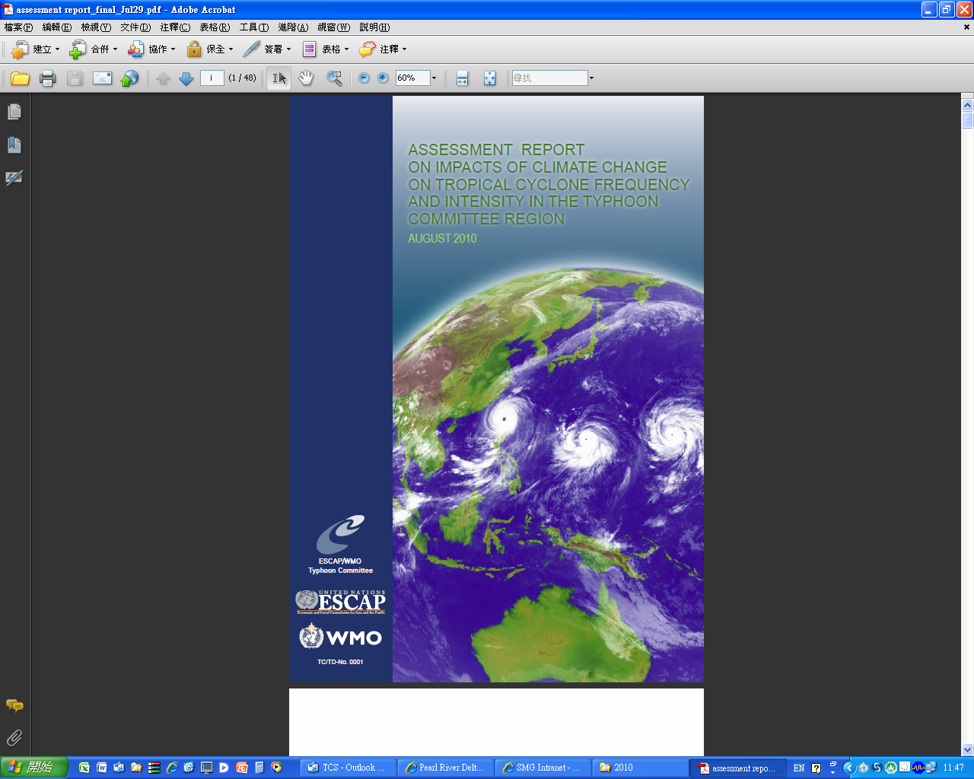
1.To publish the 1st report
The first report is already finalized and will be sent to the printing company for printing

Slide 4
2. To set up or extend the expert team
The ESCAP/WMO Typhoon Committee, at its 42nd Annual Session, held in Singapore, 25-29 January 2010, decided to form an "Expert Team to continue the assessment on the impact of climate change with the focus on the tropical cyclone track and impact area "

Slide 5
Expert team members
The composition of the Expert Team, up to now, is as follows:
Mr. Tetsuo Nakazawa (Meteorological Research Institute - MRI/JMA, Japan);
Mr. Tsz Cheung Lee (Hong Kong Observatory, Hong Kong, China);
Ms. Ying, Ming (Shanghai Typhoon Institute, CMA, China);
Mr. Tom Knutson (NOAA Geophysical Fluid Dynamics Laboratory)
Expert team coordinator: Mr. Leong Weng Kun (Macao Meteorological and Geophysical Bureau- Macao,China).
Still waiting for the member from KMA

Slide 6
3. To make a draft of the 2nd report
Contents of the 2nd report (first draft of the outline) made by Dr. Lei (WGM chair)
Introduction
Tropical cyclone track
Tropical cyclone impact area
Future Projections
Uncertainties
Recommendations for Future Work
References

Slide 7
(1) Introduction
To emphasize this is the 2nd assessment report on impacts of climate change on tropical cyclone by Typhoon Committee
To introduce Typhoon Committee decided to form an expert team again at the 42nd session held in Singapore to assess the impacts of climate change further on tropical cyclone track and impact area in the Typhoon Committee region.
Introduce this project to policymakers and public
To introduce the content of the 2nd report and the members of the expert team

Slide 8
(2) Tropical cyclone track
Generation source
Moving speed and direction
Abnormal movement

Slide 9
(3)Tropical cyclone impact area
Duration of life
Hit or impact region
- base on wind and rain caused by tropical cyclones
- a section for each Member

Slide 10
Plan for 2010, 2011 and after
2010/SEP
- Set up the expert working team for the 2nd report
(TCS, liaison man, WGM in charge)
Award a letter of appointment to the expert team members
(TCS in charge)
- Draft an outline for the 2nd report and the implementation scheme (expert team leader, liaison man, WGM in charge)

Slide 11
Plan for 2010, 2011 and after
2010/DEC
Hold the expert symposium
(expert team, liaison man, TCS, WGM in charge)
Discuss and determine the outline of the report
(expert team in charge)
Discuss and determine the implementation scheme
(expert team in charge)

Slide 12
Plan for 2010, 2011 and after
2011/JAN-AUG
Collect data of progress of work from each member states
Collect data of progress of work from expert team’s each member
(expert team in charge)
2011/SEP
Complete the first draft and solicit opinions on the IWS meeting
(expert team in charge)

Slide 13
Plan for 2010, 2011 and after
2012/JAN
Solicit opinions on the 44th session
(expert team in charge)
2012/FEB-AUG
- Revise and publish
(expert team in charge)

Slide 14
Opinions are welcomed
Thank you

